Slide 1
Please play this as a Slide Show – it will be helpful

Slide 2
Skyline Library
MLA Intro Part II

Slide 3
1) Please log on a computer
If you haven’t been on a school computer this year, this is your login info
Username: up to FOUR letters of your last name, up to THREE letters of your first, TWO digit grad year
Password: seven-digit ASB number
2) Get our your library homework (the ‘bookmark’)
3) Open the web and then…
4) Go to the Skyline Library page
via SHS main page > Library on right under Student Resources (or www.msbacon.com)
5) And get out your notes from yesterday.
6) Thank you!

Slide 4
Some notes
Three Main Rules of the Library…
Do NOT eat or drink (water’s okay) in the library
Do NOT reshelf your books
Be respectful and ask for help!
Get out headphones if you have them.

Slide 5
Formatting your paper in MLA
Margins
One Inch
Font
Times New Roman, 12 pt
Line Spacing
Double-spaced
Alignment
Left aligned
Header (above the margins)
Last name & page number
Heading (four things)
Your full name
Teacher’s name
Class name , period
Date – the DUE DATE with month written out
Even if not asked, add a…
title

Slide 6
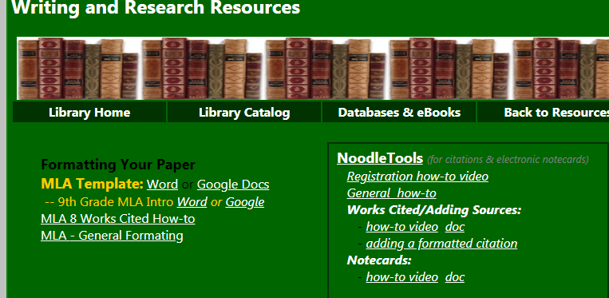
MLA Paper Formatting Template
Go to: Library Page > Resources by Subject > Research and Writing> 9th Grade MLA Intro Template: Word OR Google Doc
Personalize it!
Due date is tomorrow: September 14, 2018
If you are using Word, save this to your server folder > File > Save as > click on Computer to the left > then see your server file with your name on the right.

Slide 7
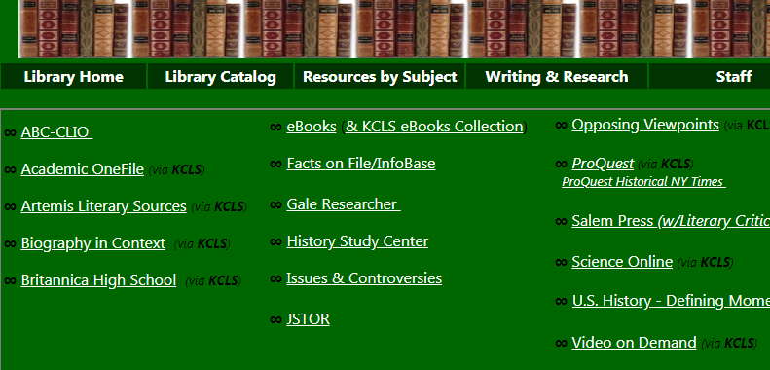
Databases
From the Skyline Library homepage , choose “Databases & eBooks”
Go to the “KCLS” database you chose for your homework.
Log in to the database
Use info on bookmark:
your user name is 411 followed by your ASB#
your pin is the last four digits of your ASB#

Slide 8
Search for A Topic in Database
Search for anything that you will be studying this year in Language Arts or Social Studies.
From the results list, open any article.
Then find the citation…

Slide 9
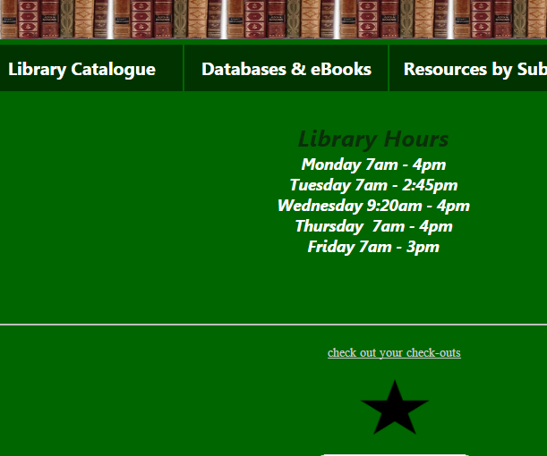
Note: Accessing Databases from Home
Passwords and other access info can be found if you click on the black star on the library home page:

Slide 10
NoodleTOOLS
Login to NoodleTools
You signed up for an account for homework if you didn’t already have an account.
Create a new Project…

Slide 11
Noodletools New Project
1. After you register or login, you will see a screen like this:
2.

Slide 12
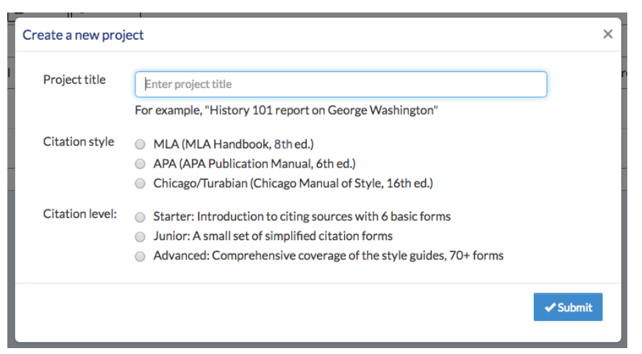
Setting up your project
1. When the Create a New Project screen that pops up, enter a name for your project, your choice.
2. Then select “MLA” for the citation style
3. And “Junior” for the citation level
4. Click Submit.

Slide 13
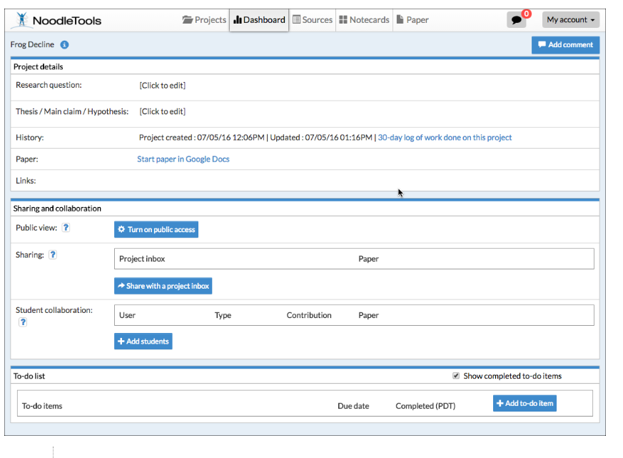
The Dashboard screen appears. There is a lot going on here, for now, you just want to choose the “Sources” tab.
This will be where you add your two sources for this assignment.

Slide 14
Adding Sources to Noodletools & Making a WORKS CITED Page
General Instructions:
1. You are going to add two sources to your new project
One database (copy and pasting citation)
One book (using the ISBN number)
2. You are going to make a works cited page with these two sources from NoodleTools.
3. You are going to copy and paste this works cited to your 9th Grade MLA Intro Template that you already made.
4. You will decide what the in-text citation should be for both sources.
5. You will print this out and turn it in.
For #1 and #2, you will be watching a how-to video; that’s why you need your headphones.
- If you need headphones, there are some at the front desk

Slide 15
Adding Sources to Noodletools & Making a WORKS CITED Page
Click on this video, it will show you how to add citations.
Skyline Library Page > Writing & Research > (under NoodleTools) how-to-video
You will be adding one DATABASE citation (you have a database open and know where to find the citation to cut and paste.
you can skip ahead on the video to about 1:42 for the description adding a database
And you will be adding one BOOK citation (you have a book at your table)
you can skip ahead on the video to about 4:40 for the description adding a book
Once you have added these two sources, you are going to turn this into a Works Cited Page.
you can skip ahead on the video to about 5:30 for the description of how to do this

Slide 16
Copy and Paste your Works Cited
Second to last step!
Copy and paste the citations in your new Word or Goolge document on to the 2nd page of your open MLA 9th grade template.

Slide 17
Add In-Text Citations
Last Step!
On your 9th grade template, look at Page 1
Add the correct in-text citations in the parentheses… your two sources are on page 2.
Notes:
- Remember, what goes in an in-text citation is the first word of the entry in your Works Cited – usually a last name if there is an author, if not it is the first word of the article title.
- If the first word is in quotes, keep it in quotes.
- For your book source, you need a page number; for this mock assignment, you can make up a page number – and just put the number, don’t add ‘page’ or ‘pg’ or ‘p.’ example: (Smith 14).

Slide 18
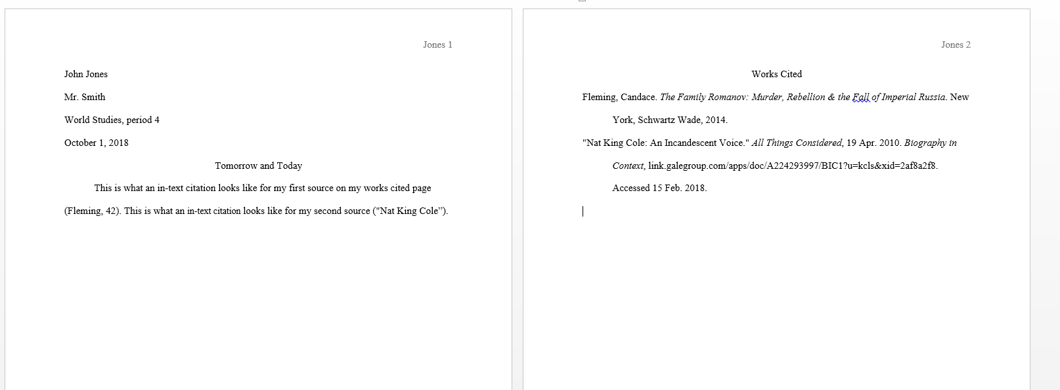
What you will turn in will look something like this…
Page 1
Page 2

Slide 19
Print It!
Now print the assignment!
Our printer automatically prints double-sided so
Turn it in in the pile by the printer
If you don’t finish today, please finish tonight and turn in tomorrow.

